Slide 1
Hospital Management System
January 18, 2024

Slide 2
FACULTY NAME Dr. Subash Harizan SUBMITTED BY | NIRAJ KUMAR | MANISH MANDAL | VIKAS KUMAR SAH | | 22SCSE1011423 | 22SCSE1012598 | 22SCSE1011375 |
GALGOTIAS UNIVERSITY

Slide 3
System Architecture
The system is built using Java and incorporates AI for advanced features.
Key components include the Patient class, Doctor class, and Main Driver class.
The interaction flow among classes facilitates seamless patient and doctor management.
JDBC is used for database connectivity to a MySQL database.

Slide 4
Patient Class
The Patient class includes methods for adding patients, viewing patient information, and getting a patient by ID.
Input validation is implemented to ensure the accuracy and integrity of patient data.
The addPatient method validates and inserts patient data into the system.
The viewPatients method displays the information of all the registered patients.

Slide 5
Doctor Class
1
2
3
Method functionalities for the Doctor Class: viewDoctors to display doctor information, getDoctorById to check doctor existence.
Example of how these methods work in the system.
Discussion of how these methods could be expanded or modified in the future.

Slide 6
Database Connection
Establishing JDBC connection to the MySQL database
Configuring the URL, username, and password for database connectivity
Handling database operations for patient and doctor information

Slide 7
Main Driver Class
1
2
3
4
Integration of Patient and Doctor classes
User interface using Scanner for user interaction
Menu-driven functionalities for adding patients, viewing patients and doctors, booking appointments, and exiting the system
Initialization of the system and database connections

Slide 8
Java-based Hospital Management System Overview
1
2
3
Brief explanation of Hospital Management System (HMS)
Importance of effective hospital management
Overview of the application

Slide 9
Objective
HMS Features and Functionalities
Goal of the Implementation
Detail the purpose of the Hospital Management System (HMS)
List the key features of the HMS, such as patient management, appointment scheduling, etc.
Explain the objectives of implementing the HMS, such as improving efficiency and patient care
Detail the purpose of the Hospital Management System (HMS)
List the key features of the HMS, such as patient management, appointment scheduling, etc.
Explain the objectives of implementing the HMS, such as improving efficiency and patient care

Slide 10
Technologies Used
Java Programming Language
MySQL Database
JDBC for Database Connectivity

Slide 11
Database Configuration
Connection Details
Key Points
URL, username, and password are required for the database connection.
The JDBC driver is used to establish a connection between the Java application and the database.
URL, username, and password are required for the database connection.
The JDBC driver is used to establish a connection between the Java application and the database.

Slide 12
Class Overview
Patient Class
Attributes and Methods: Connection, Scanner, addPatient(), viewPatients(), getPatientById(int id).
Doctor Class
Attributes and Methods: Connection, viewDoctors(), getDoctorById(int id).
HospitalManagementSystem Class
Attributes and Methods: Connection, Scanner, main(String[] args), bookAppointment(patient, doctor, connection, scanner), checkDoctorAvailability(doctorId, appointmentDate, connection).

Slide 13
Patient Class Implementation
Brief explanation of the Patient class
Code snippet of addPatient() method
Code snippet of viewPatients() method
Code snippet of getPatientById(int id) method

Slide 14
Doctor Class Implementation
Class Explanation
Brief explanation of the Doctor class
View Doctors Method
Code snippet of the viewDoctors() method, which presumably displays a list of doctors
Get Doctor by ID Method
Code snippet of the getDoctorById(int id) method, used to retrieve a specific doctor's information by their ID

Slide 15
HospitalManagementSystem Class Implementation
Main Class Explanation
Brief explanation of the HMS main class and its role in the system.
Code snippet of main(String[] args) method
The main entry point of the HospitalManagementSystem class. It initiates the system and the user interface.
bookAppointment() Method
Code snippet of the bookAppointment method, which handles the process of booking an appointment between a patient and a doctor.
checkDoctorAvailability() Method
Code snippet of the checkDoctorAvailability method, which checks the availability of a doctor for an appointment on a specific date.

Slide 16
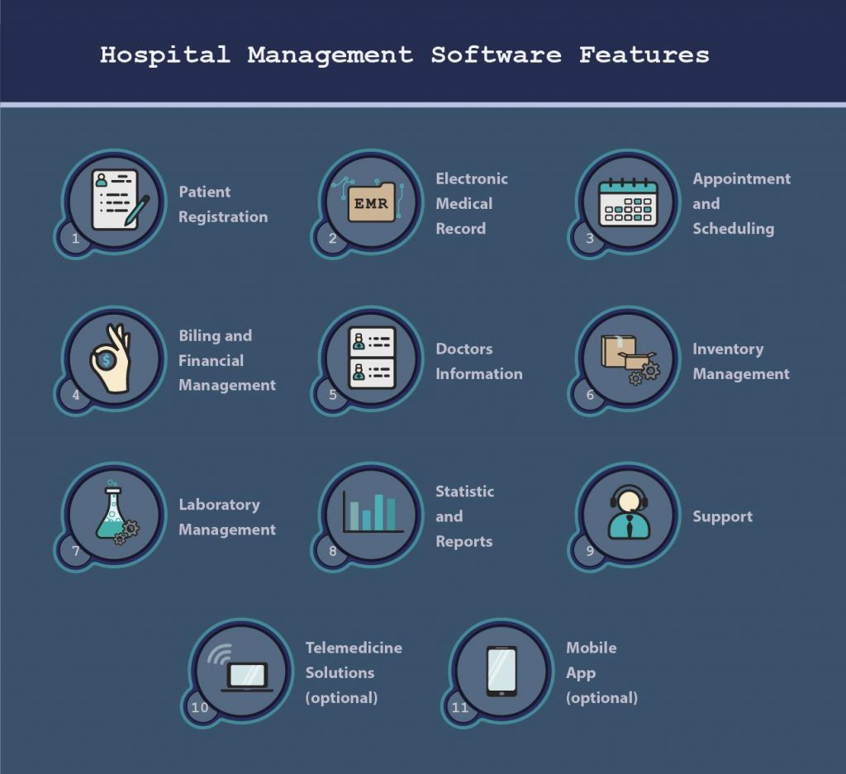
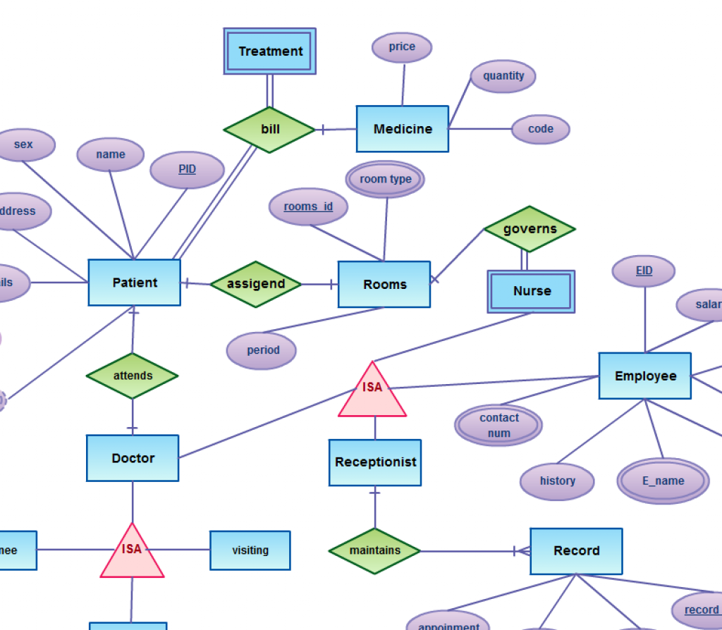
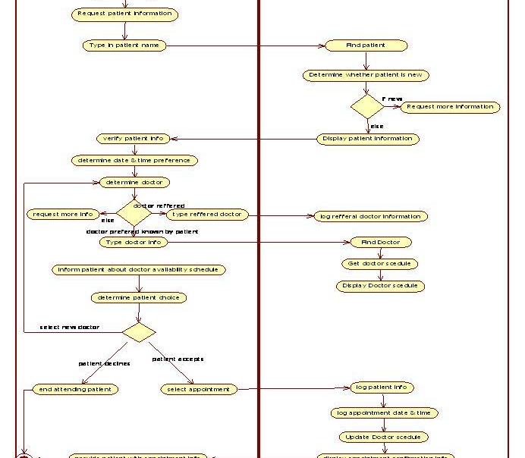
Demo
Patient Management
Doctor Management
Appointment Booking
Showcasing the feature of adding and managing patients in the system.
Demonstrating the capability to view and manage doctors in the system.
Highlighting the process of appointment booking between patients and doctors.

Slide 17

Challenges Faced
Database connectivity issues
Difficulty in handling exceptions and errors
Other challenges encountered during development
Plus tip:

Slide 18
Future Enhancements
Current Feedback and Suggestions
Possible Improvements and Features
Placeholder for future development based on user feedback.
Additional features requested by users.
Suggestions for improvements in the existing system.
Enhanced user authentication and security measures.
Integration with external systems and platforms.
Optimization of existing features for better performance.
Plus tip:

Slide 19
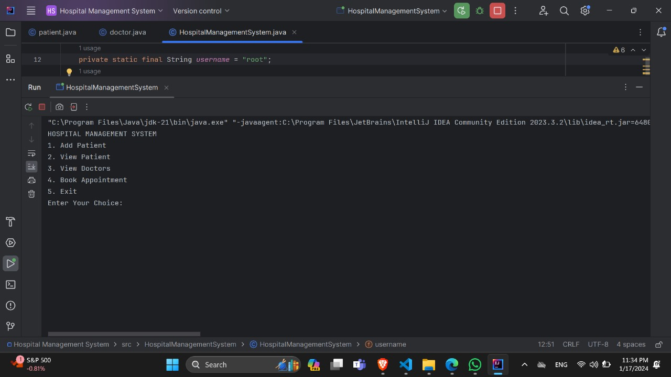
OUTPUT 1

Slide 20
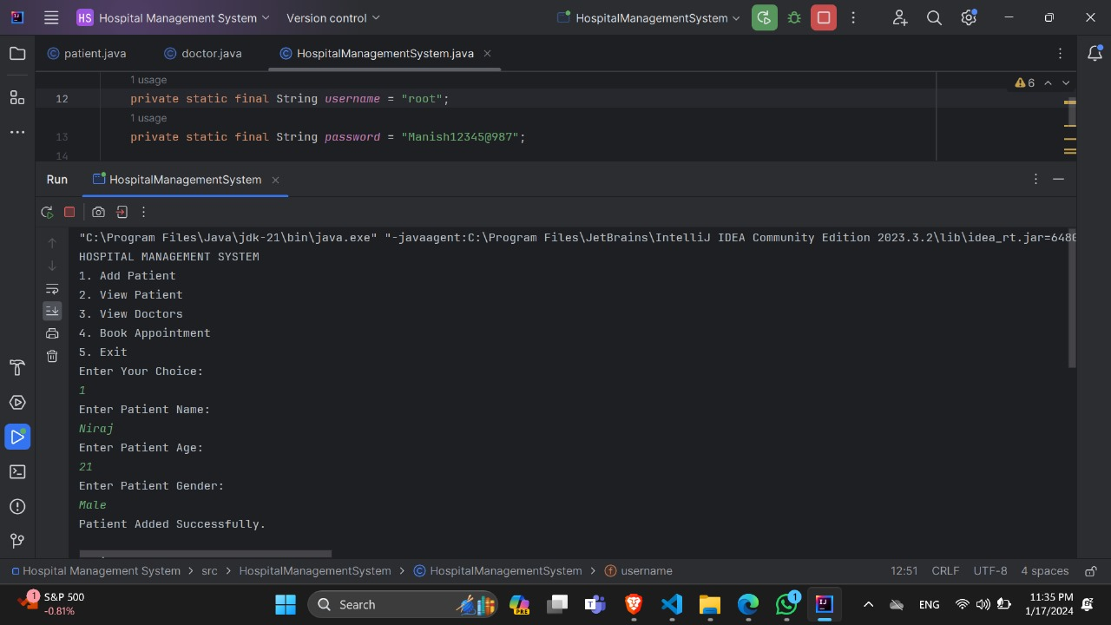
OUTPUT 2

Slide 21
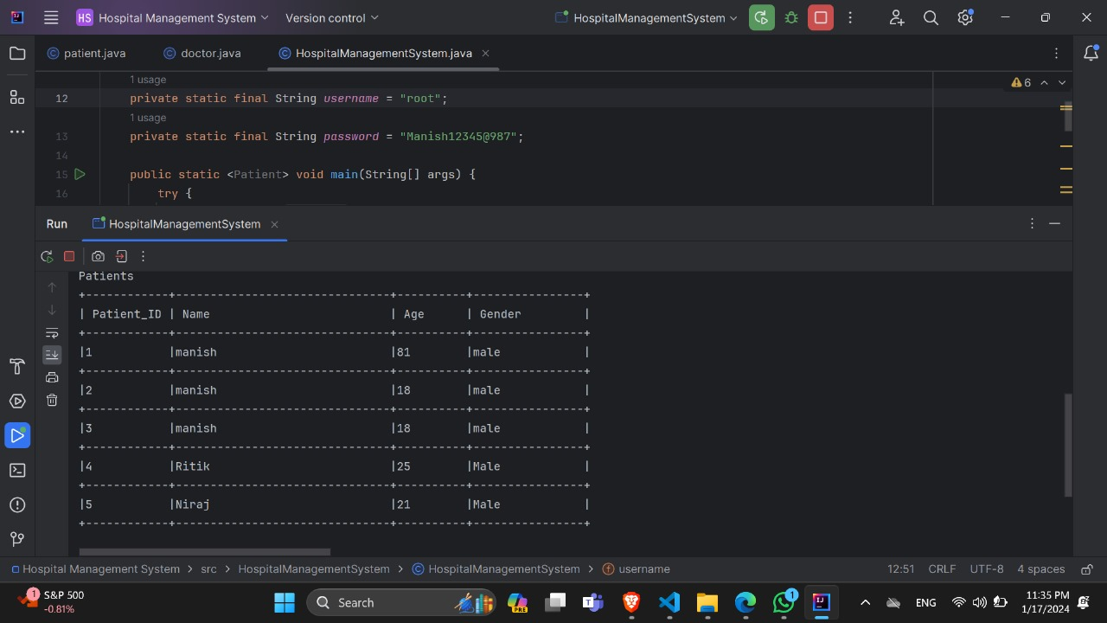
OUTPUT 3

Slide 22
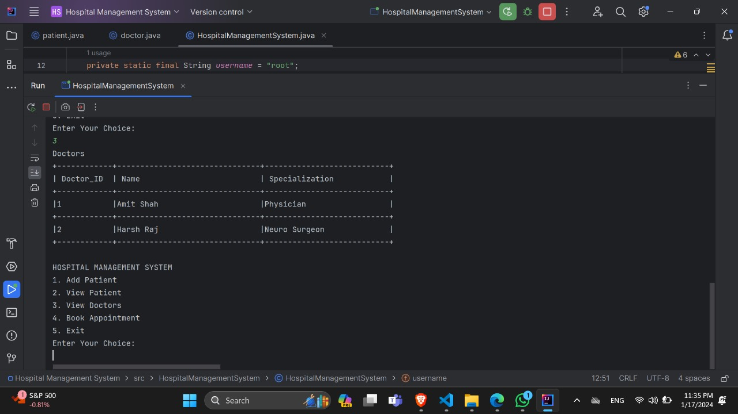
OUTPUT 4

Slide 23
Conclusion:
1
2
3
The Hospital Management System has successfully achieved its objectives in improving patient care, streamlining administrative processes, and enhancing overall efficiency.
Throughout the project, key milestones were met, including the successful implementation of essential features such as patient management, billing, and report generation.
The project has demonstrated the effectiveness of a Java-based approach in developing a comprehensive and efficient Hospital Management System.

Slide 24
Thank You
Expressing gratitude
Contact information for further inquiries
We would like to express our sincere gratitude for your attention and support throughout this presentation.
Thank you for your time and consideration.
If you have any further questions or inquiries, please feel free to contact us at the following email address: info@hospital.com.
Follow us on LinkedIn for more updates and information.

